Slide 2
Learn to Create VCF Certificates with PowerShell or Automation
Russell Hamker
Enterprise VMware Architect - Dish

Slide 3

Intro
Learn to Create VCF Certificates with PowerShell or Automation
About Me:
  Russell Hamker
    17+ years Running VMware
    VCP-VCF 9.0, VCP-VMC 2023,VCAP-DCV 2022, VCP-DCV 5-2022
    Employer – Dish Wireless
    Title – VMware Enterprise Architect
    vExpert Pro – 11+ years and running
    VMUG Leader – Wichita KS
    Twitter - @butch7903
    Tanzu Vanguard

Slide 4
Overview
This presentation is about securing your VMware Environment using Certificates
Use my PowerShell scripting to make this fast and easy!
VCF Operations can now create certificates to do this via Automation.

Slide 5
SSL
SSL: Secure Sockets Layer
It is the global standard security technology that enables encrypted communication between a web browser and an end user. It is utilized by millions of online businesses and individuals to decrease the risk of sensitive information (e.g., credit card numbers, usernames, passwords, emails, etc.) from being stolen or tampered with by hackers and identity thieves. In essence, SSL allows for a private “conversation” just between the two intended parties.

Slide 6
Why Use SSL Certificates
SSL Protects Data
SSL Affirms Your Identity
SSL Helps you Satisfy PCI/DSS Requirements
SSL Improves Customer Trust

Slide 7
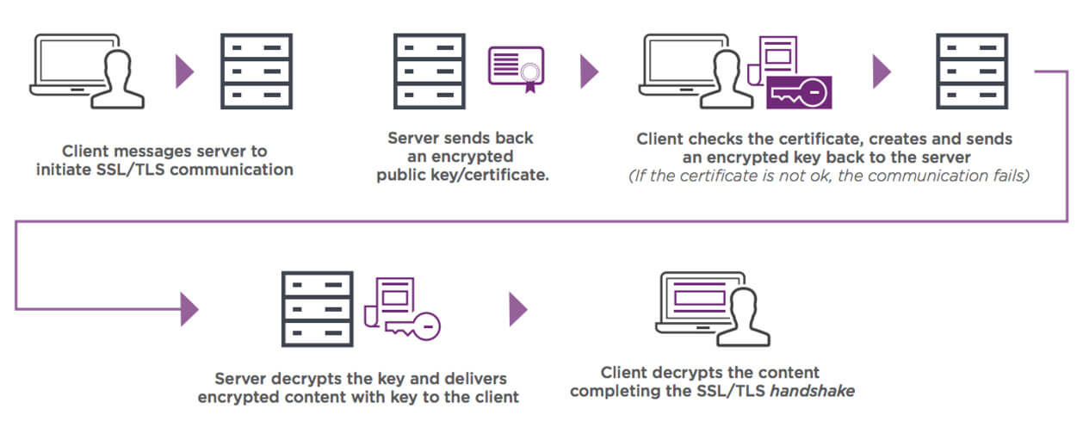
Details about the Certificate Process

Slide 8
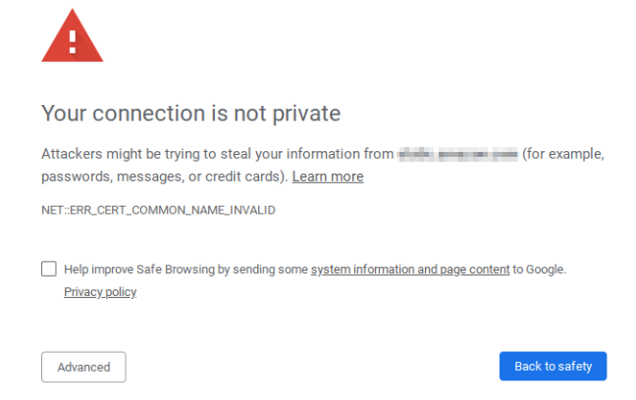
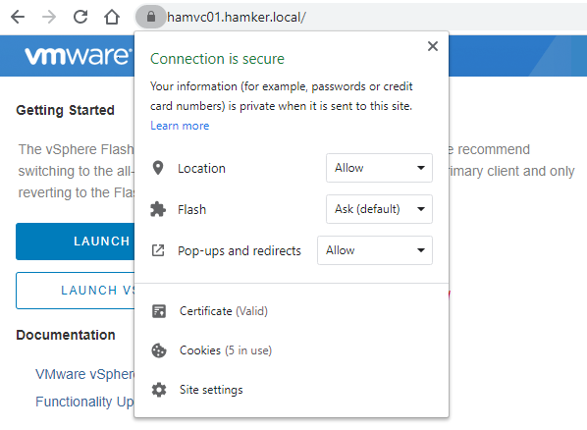
What are we trying to accomplish?
Go From This: To This:

Slide 9
Methods to Create Certificates
SSL Server Types
Internal:
  Microsoft CA
  Linux CA
External:
  Hosted CA
Methods to Make a SSL Certificate:
Use a Microsoft MMC/CA Website/PowerShell
OpenSSL
VCF Operations (VMCA or CSR/Remote CA Generation)

Slide 10
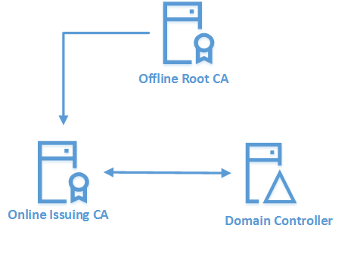
How do I see most Companies do VMware Certificates?
I see most company’s deploy a Microsoft Windows CA in a Two Tier Hierarchy.
Why?
Integration/enforcement with Active Directory
Easy to Manage
Cost is very low
Highly secure
Reference: https://www.rebeladmin.com/2018/06/step-step-guide-setup-two-tier-pki-environment/

Slide 11
Why Use PowerShell to generate Certificates?
Examples with Easy to fill-in variables to create the SSL Certificates
Provides directions post creation to assist in installation
Code is Documentation
Logs all output for documentation

Slide 12
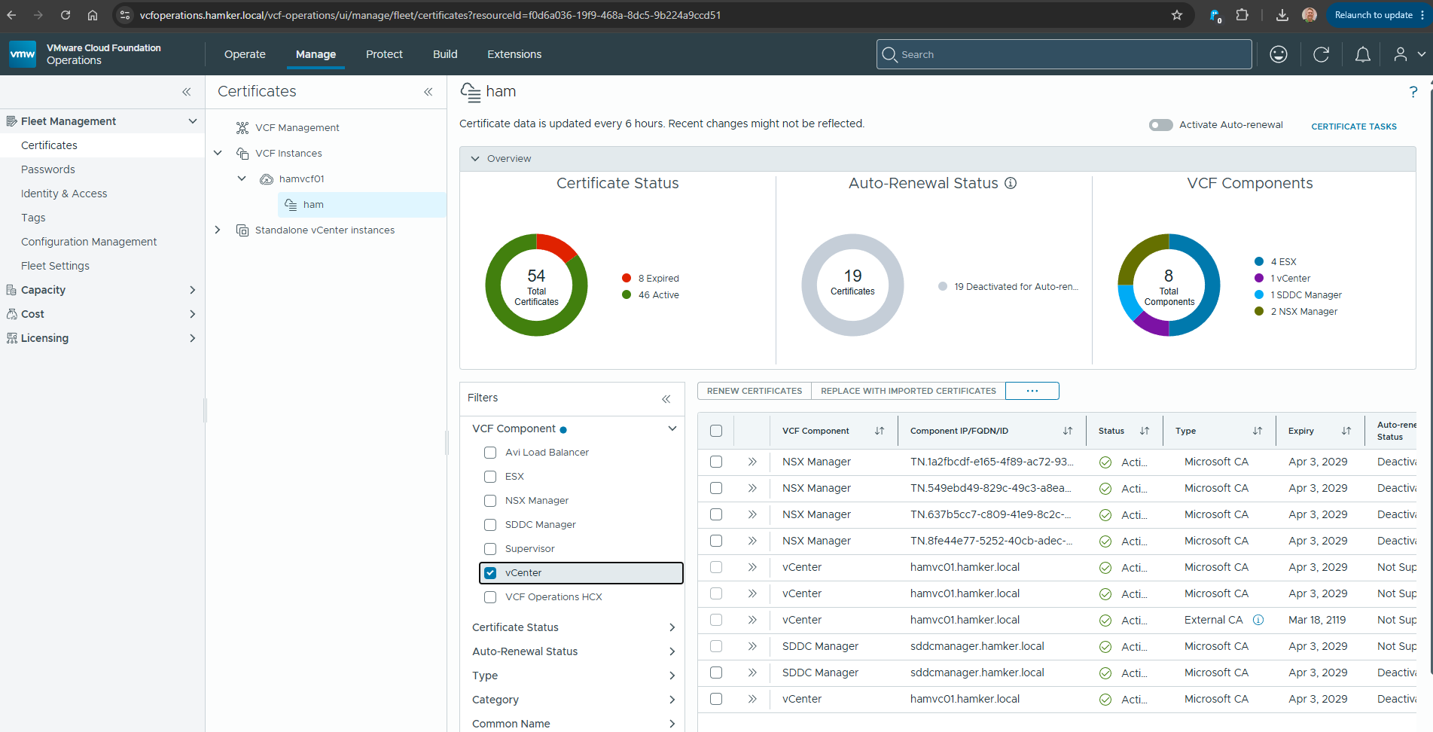
Use VCF Operations to Assist in Certificate Management

Slide 13
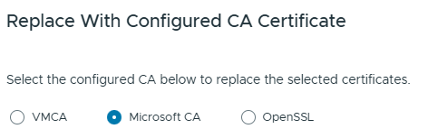
When TO use VCF Operations for Certificate Creation
Use VCF Operations internal VMCA (VMware Certificate Authority)
Use it to automate replacement of certificates (VMCA only)
Use it if you have access to a Microsoft Internal CA System
3 Different CA Methods supported by VCF Operations
VMCA (VMware Certificate Authority)
Microsoft CA
OpenSSL

Slide 14
When Not to use VCF Operations for Certificate Creation
Company does not provide application access to CA Systems
Company uses an external CA System
  Let’s Encrypt
  DigiCert
  GlobalSign
  GoDaddy
  SSL.com
  Cloudflare
Firewalls prevent access to CA systems
Company uses a CA System that is not supported by VCF Operations

Slide 15
How to set up a Windows CA
Deploy 1 or 3 CAs
Decide on your deployment model.
1 Root CA
1 Root CA + 2 Intermediate CAs
I highly recommend you make the Root and Intermediate CA certificates be for at least as long as that version of Windows is Supported.
AKA 10 years or so.

Slide 16
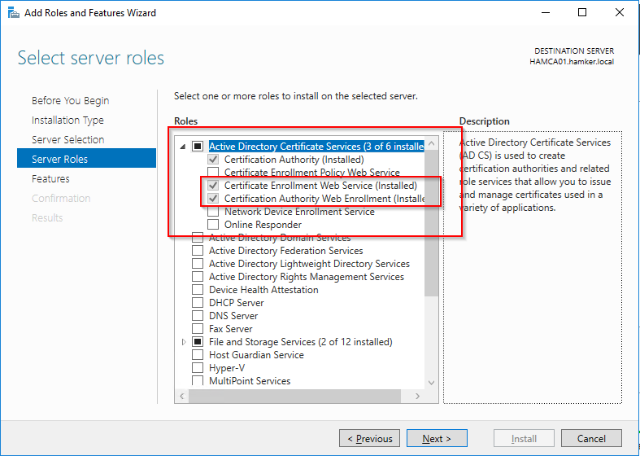
If you plan to use VCF Operations with a Windows CA
Enable Web Enrollment
https://techdocs.broadcom.com/us/en/vmware-cis/vcf/vcf-5-2-and-earlier/4-5/administering/certificate-management-admin/configure-vmware-cloud-foundation-to-use-microsoft-ca-signed-certificates-admin/prepare-your-certificate-authority-to-enable-sddc-manger-to-manage-certificates-admin/install-microsoft-certificate-authority-roles-admin.html

Slide 17
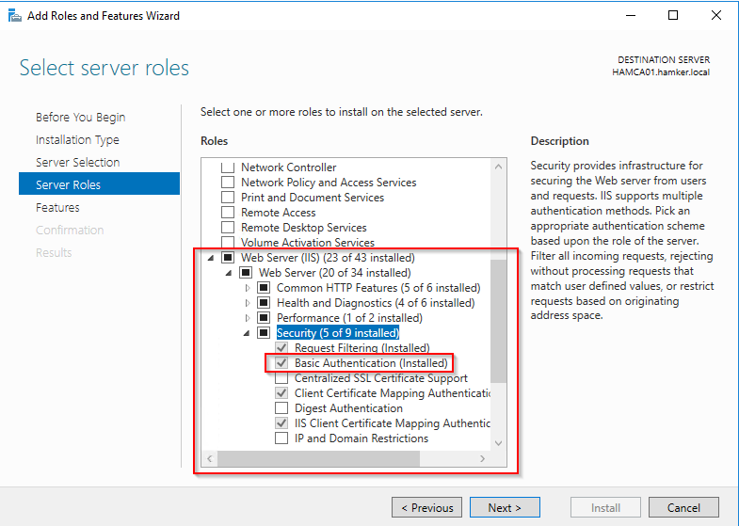
Windows CA IIS Configuration
Enable IIS Basic Authentication

Slide 18
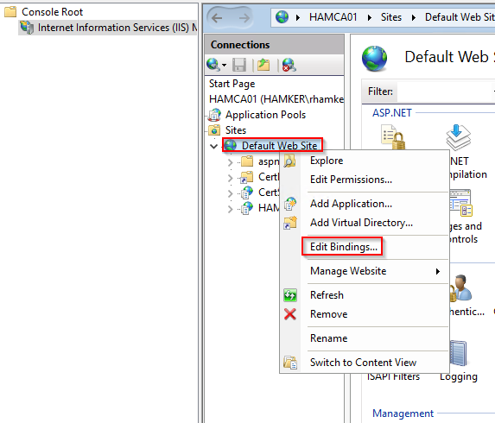
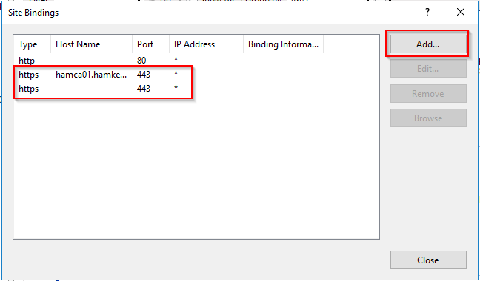
Configure CA – Configure IIS Bindings
Enable HTTPS / 443

Slide 19
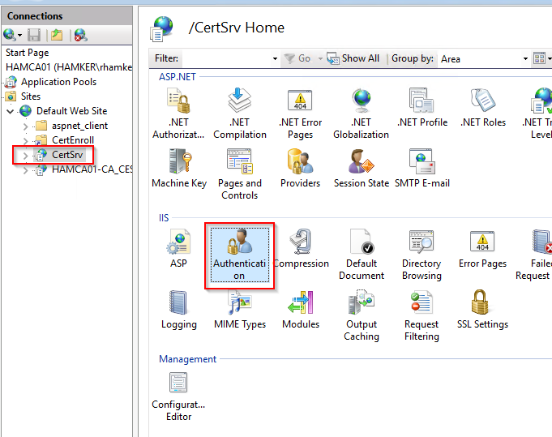
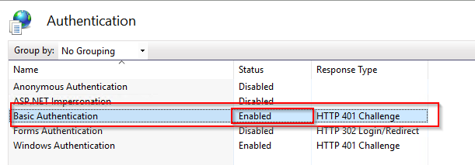
Configure Windows CA with IIS – Enable Basic Authentication
Required for VCF Operations to Connect to the Windows CA IIS Web Service
https://techdocs.broadcom.com/us/en/vmware-cis/vcf/vcf-5-2-and-earlier/4-5/administering/certificate-management-admin/configure-vmware-cloud-foundation-to-use-microsoft-ca-signed-certificates-admin/prepare-your-certificate-authority-to-enable-sddc-manger-to-manage-certificates-admin/configure-the-microsoft-certificate-authority-for-basic-authentication-admin.html

Slide 20
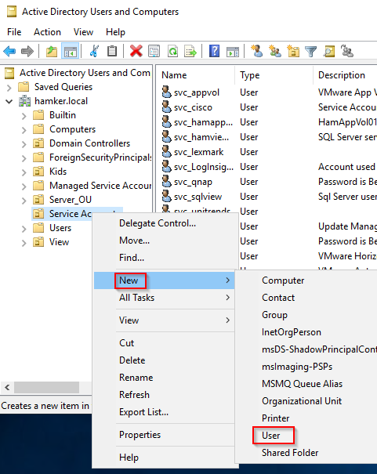
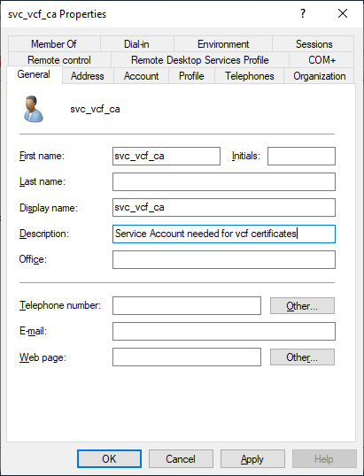
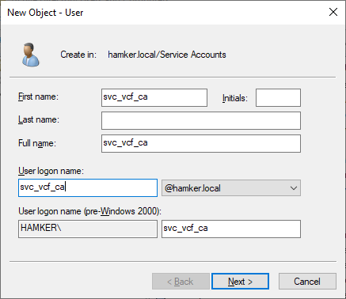
VCF Operations – Create AD Service Account
Configure a VCF AD Service Account for Certificate Creation

Slide 21
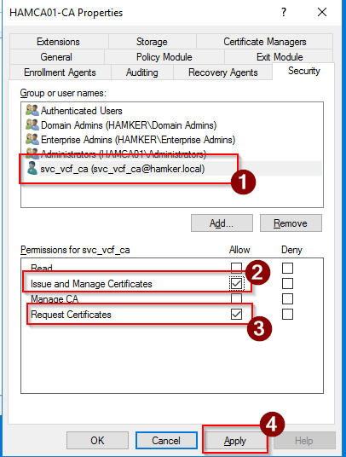
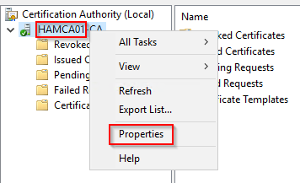
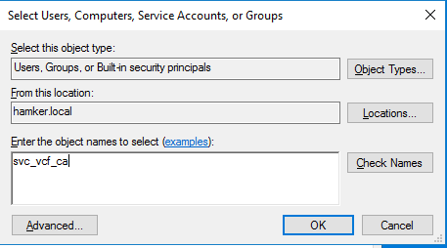
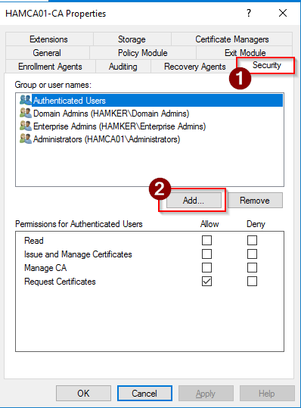
VCF Operations – Allow Service Account to Create Certificates

Slide 22
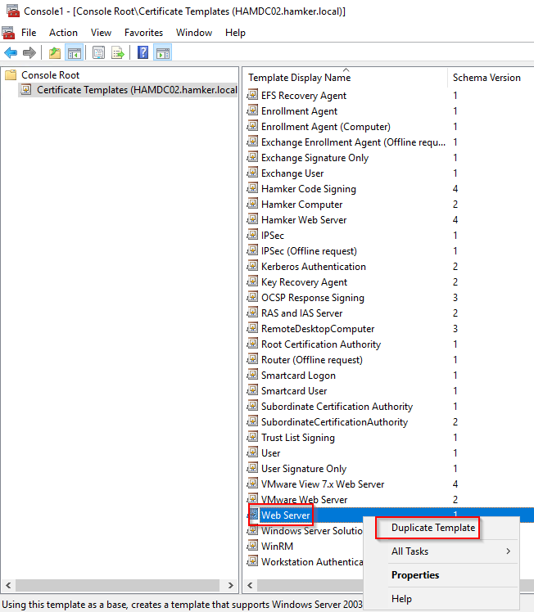
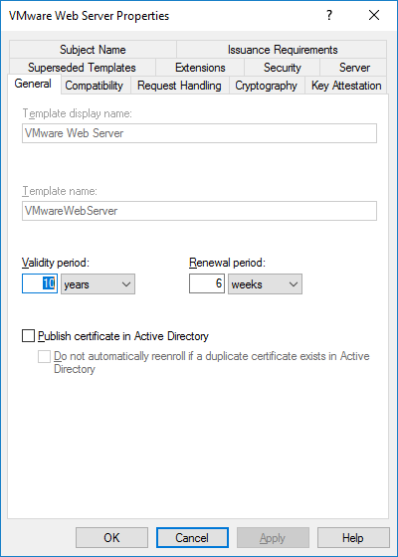
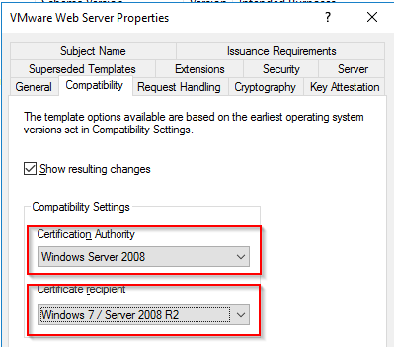
For PowerShell or VCF Operations – Create Certificate Template
Open Certificate Template Console – certtmpl.msc

Slide 23
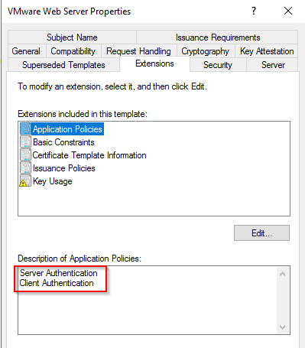
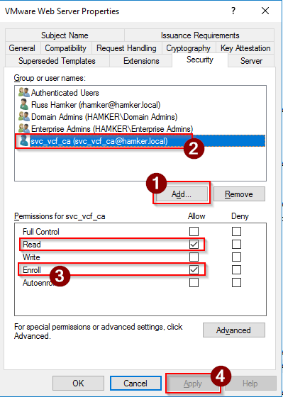
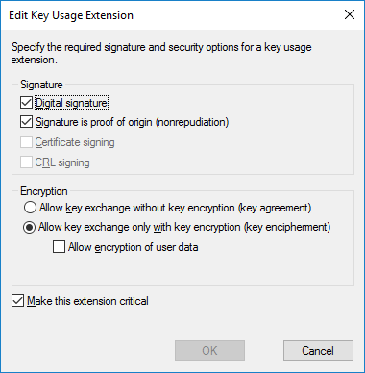
VMwareCertificate Template Details

Slide 24
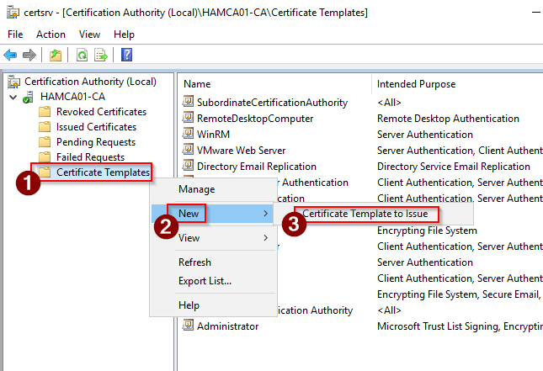
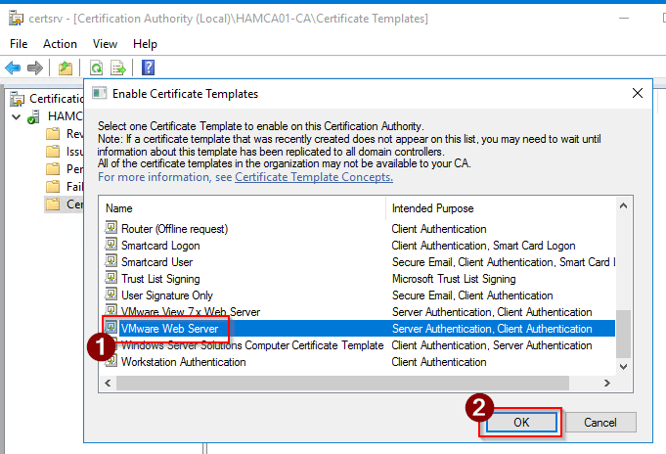
Add the Template to the CA
Open certsrv.msc

Slide 25
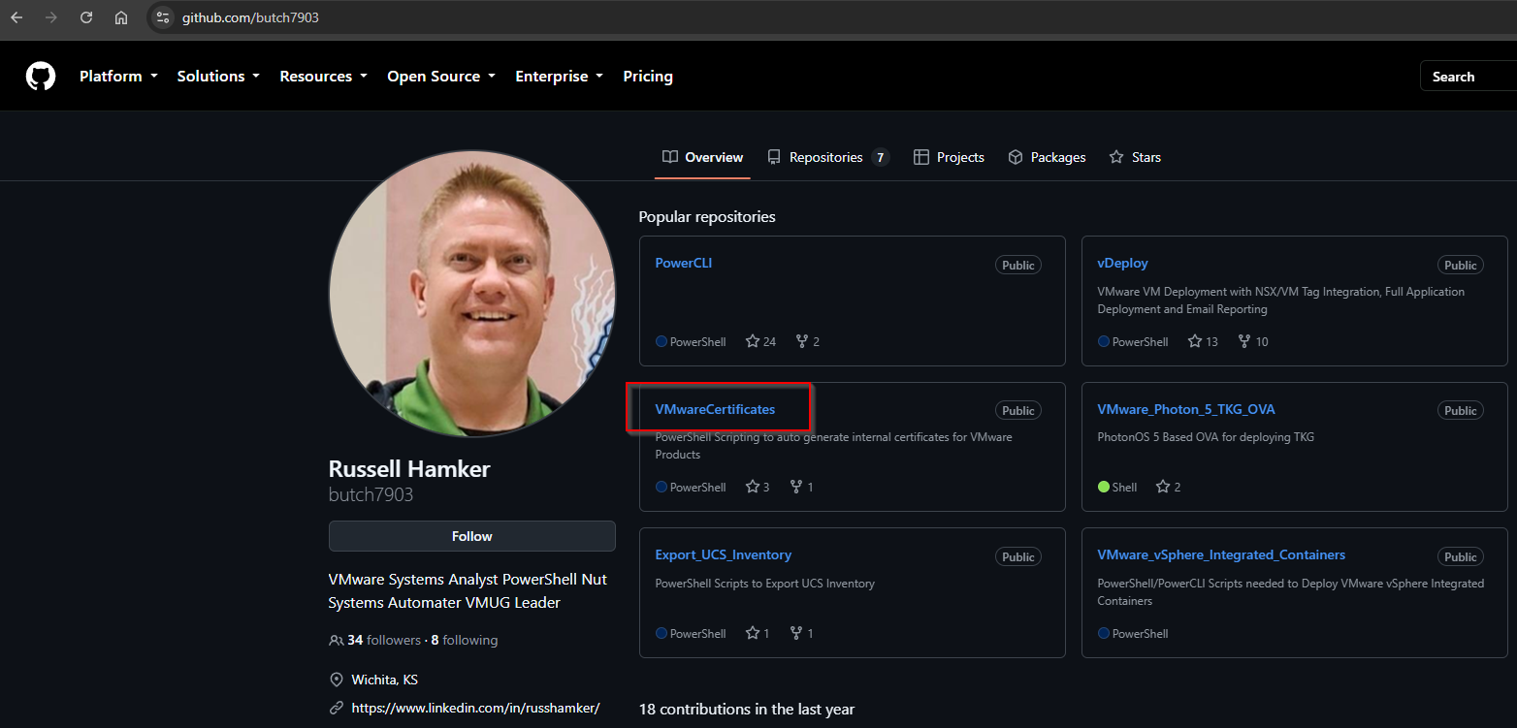
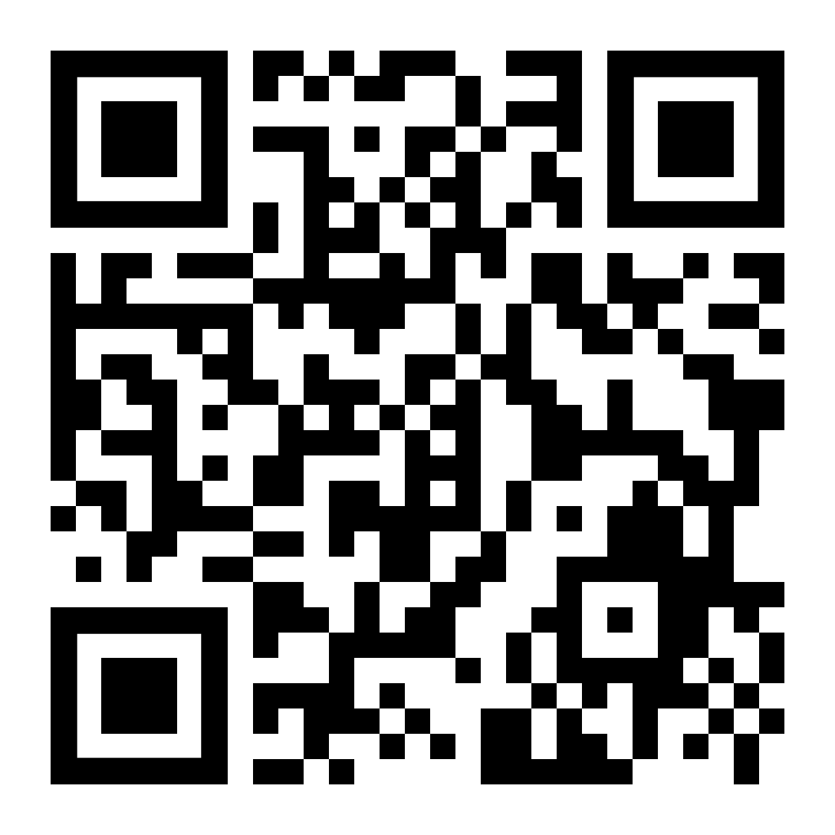
If you wish to do PowerShell Certificates
Download my Github - https://github.com/butch7903

Slide 26
Create a Certificate via PowerShell
Order to Run Scripts In
Create your CA PEM files first. If it has already been generated previously, you can
skip this step
  Edit the Generate Root and Intermediate Certificates From Internal CA.ps1 script
  for your Root and Intermediate CAs
  Run the script to generate the Certificates in the proper format
Run the Script for the VMware Product you wish to generate a certificate for. Example: VCSA
  Update the Variables for your Certificate you wish to create.
  Run the script.
    If you do not have rights to generate Cerificates
      If you do not have rights to generate Cerificates with your MS CA, it will create the Key and CSR for you to provide to your CA administrator.
      After you receive the .cer file back from the CA Admin, save it in the same folder with the short VCSA name
      Run the Script a second time to complete the Certificate Generation Process
    If you have rights to generate Cerificates
      If you have rights to generates certificates with your MS CA, run the command line utility to find the VMware CA Template
      Update the PowerShell script with the VMware CA Template Name
      Run the Script to generate all files needed
  In the Script’s Logs you will find direction for how to replace the Certificate of said product

Slide 27
PowerShell Creation Demo
IT’S DEMO TIME!!!

Slide 28
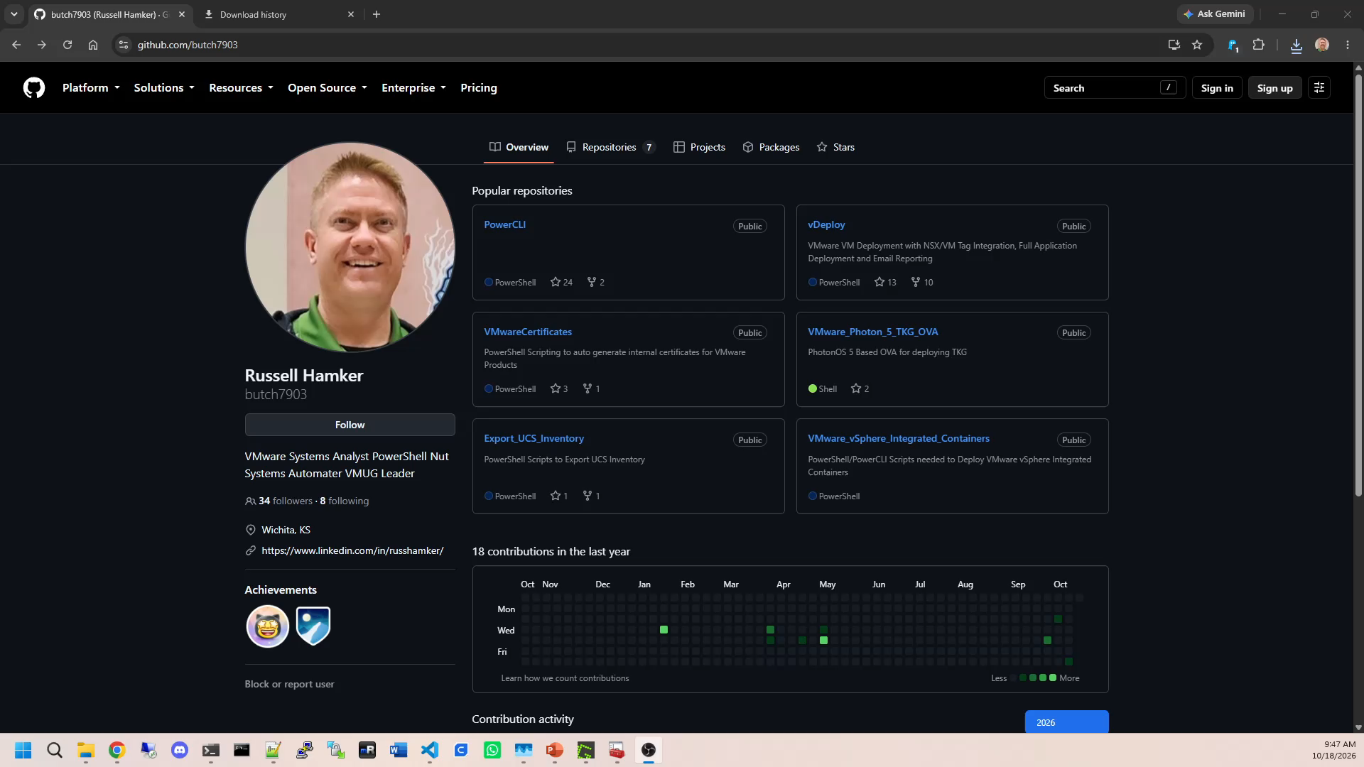

Slide 29
Update your VCF Operations Certificate – From PowerShell
DEMO!!

Slide 30
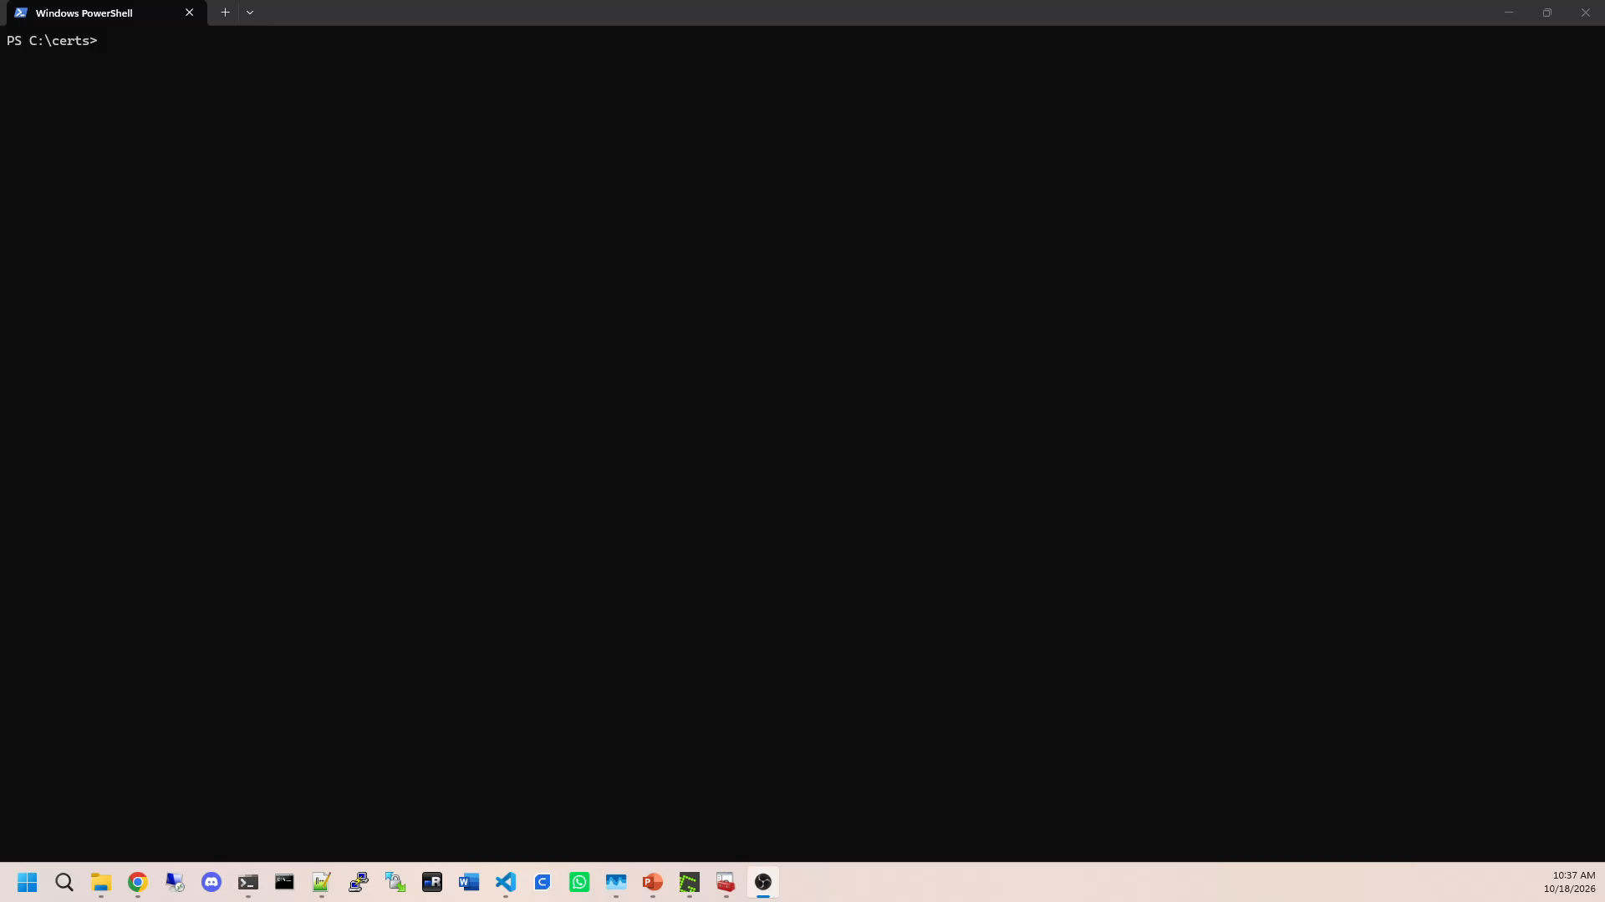

Slide 31
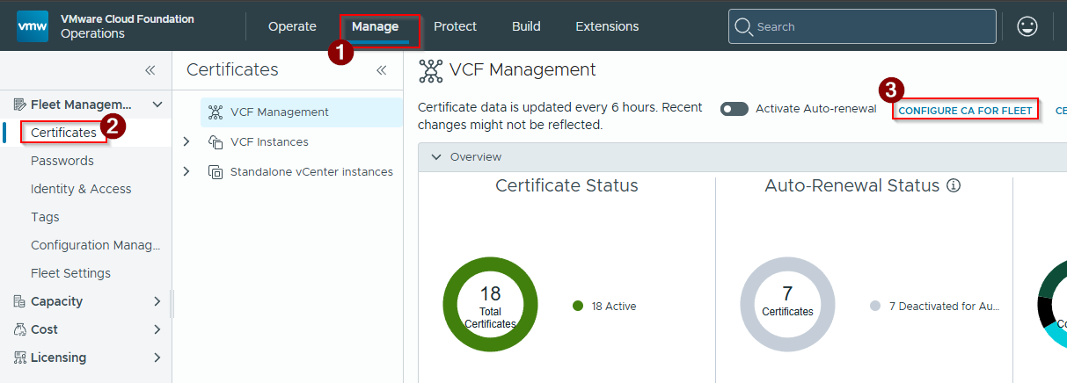
Configure VCF Operations to work with your Windows CA
Steps:
Log in to your VCF Operations Interface using the admin accout
Go to Manage > Certificates
Click on Configure CA For Fleet

Slide 32
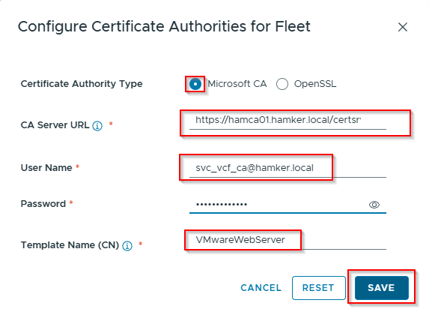
Configure Microsoft CA For Fleet
Steps:
Select Microsoft CA
CA Url - https://CAFQDN/certsrv
Username – username@domain
Password – Password for service account
Template (No Spaces)
Click Save

Slide 33
Steps to renew/replace VCSA certificate using VCF Operations
DEMO!!!

Slide 34
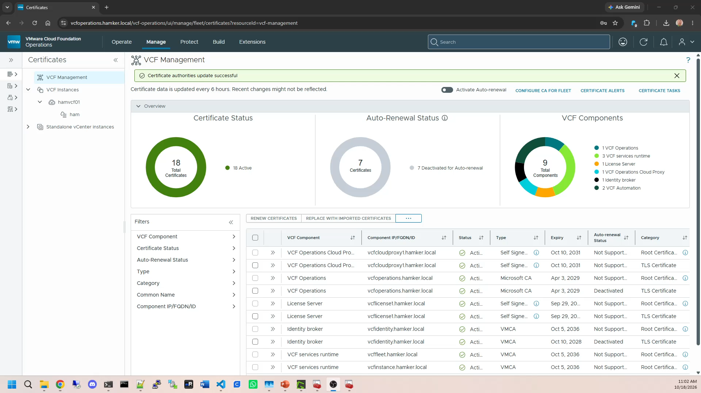

Slide 35
Questions???

Slide 36
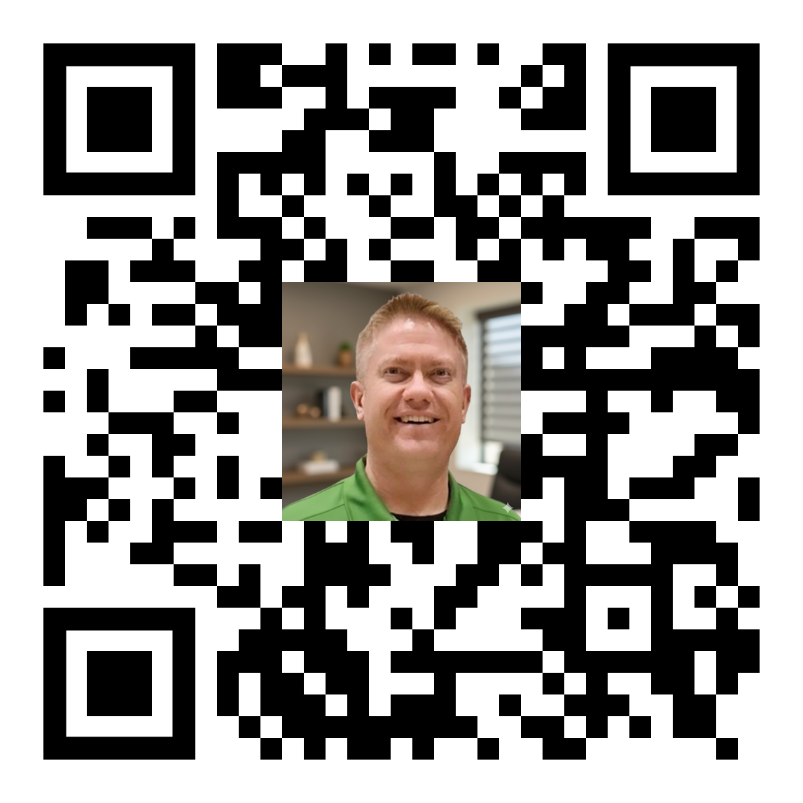



Thank You
Russell Hamker
Enterprise VMware Architect
https://github.com/butch7903
Twitter: @butch7903
LinkedIn: https://www.linkedin.com/in/russhamker/

Slide 37
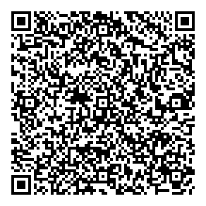
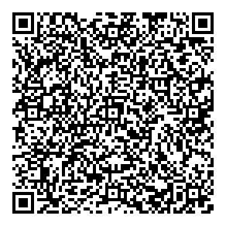
Did you enjoy the session?
Your Feedback Is Important
  Please take a minute to complete the survey session in the mobile app.
    Navigate to this session
    Take this survey
    Enjoy your next session!
Download the VMUG Connect app
Make the most of your time onsite.
Google Store
App Store

Slide 38


From Connect to Community - What’s Next?
Make the Most of Your Time at Connect!
  Take a Certification Exam – Prove your skills and boost your career.
  Meet Your Local Leaders – Find out how to stay involved year-round.
  Explore Partner Solutions – Get hands-on with the latest VMware innovations.
  Upgrade to VMUG Advantage –Unlock exclusive training, personal-use homelab licenses, and more!
Keep Exploring, Learning, and Networking!
  Join your local VMUG Chapter
  Tap Into Advantage Benefits
  Follow VMUG on Social – Stay in the loop and share your experience! #VMUGConnect
  Mark Your Calendar for VMware Explore – Be part of the biggest VMware event of the year. VMUG cannot wait to see you there
  Look out for Global Virtual Events on vmug.com
Ready to take the next step?
Visit VMUG.com and stay connected!

